Slide 1

Individual Project Presentation by Arafat Ahmed MIS 502, Spring 2023

Slide 2
Introduction - About Dataset
Context
A person/patient makes a doctor appointment, receives all the instructions plus SMS and did not show up. Whom to blame?
Content
There are total 110,527 medical appointments (records)
with 14 associated variables (characteristics and column).
The most important one is, if the patient show-up or no-show to the date and time of the appointment.

Slide 3
AIM
The objective of my analysis is to find out the factors affecting the no-show of the patients during the day of appointments and how much impact they have on this result.

Slide 4
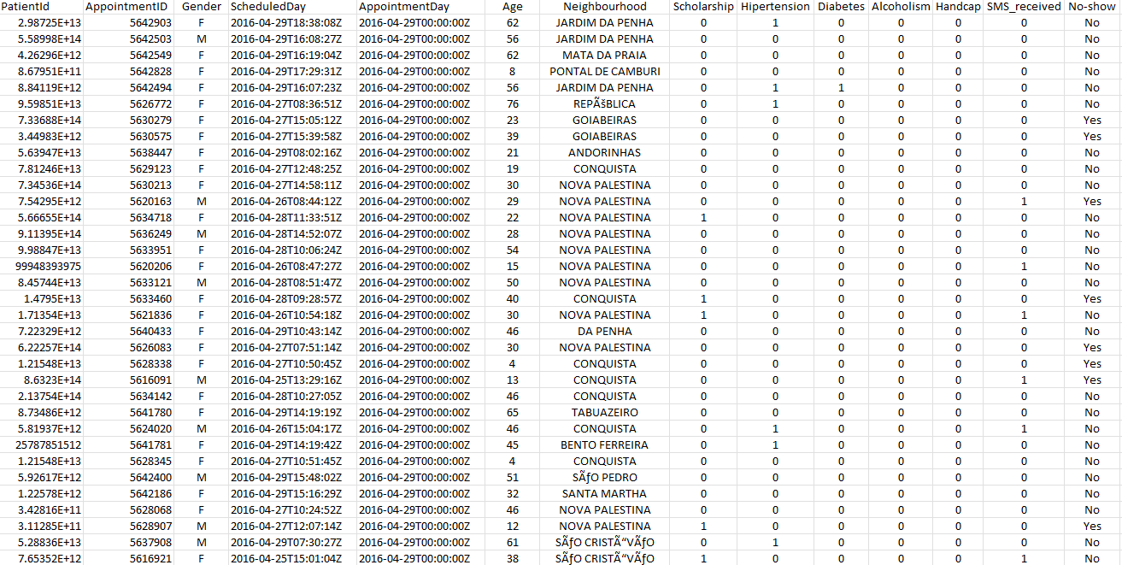
Data set at a glance

Slide 5
Data Dictionary ( Description of data )
01 – Patient ID
Identification of a patient
02 – Appointment ID
Identification of each appointment
03 - Gender
Male or Female . Female is the greater proportion; woman takes way more care of they health in comparison to man.
04 - Appointment Day
The day of the actual appointment, when they have to visit the doctor.
05 – Scheduled Day
The day someone called or registered the appointment, this is before appointment of course.
06 - Age
How old is the patient.
07 - Neighborhood
Where the appointment takes place - Brazil
08 - Scholarship
True of False .
A social welfare program of the Government of Brazil, part of the Fome Zero network of federal assistance programs. Bolsa Familia provided financial aid to poor Brazilian families
09 - Hypertension
True or False
10 - Diabetes
True or False
11 -Alcoholism
True or False
12 - Handicap
True or False
13 - SMS received
1 or more messages sent to the patient.
14 - No-show
True or False.

Slide 6
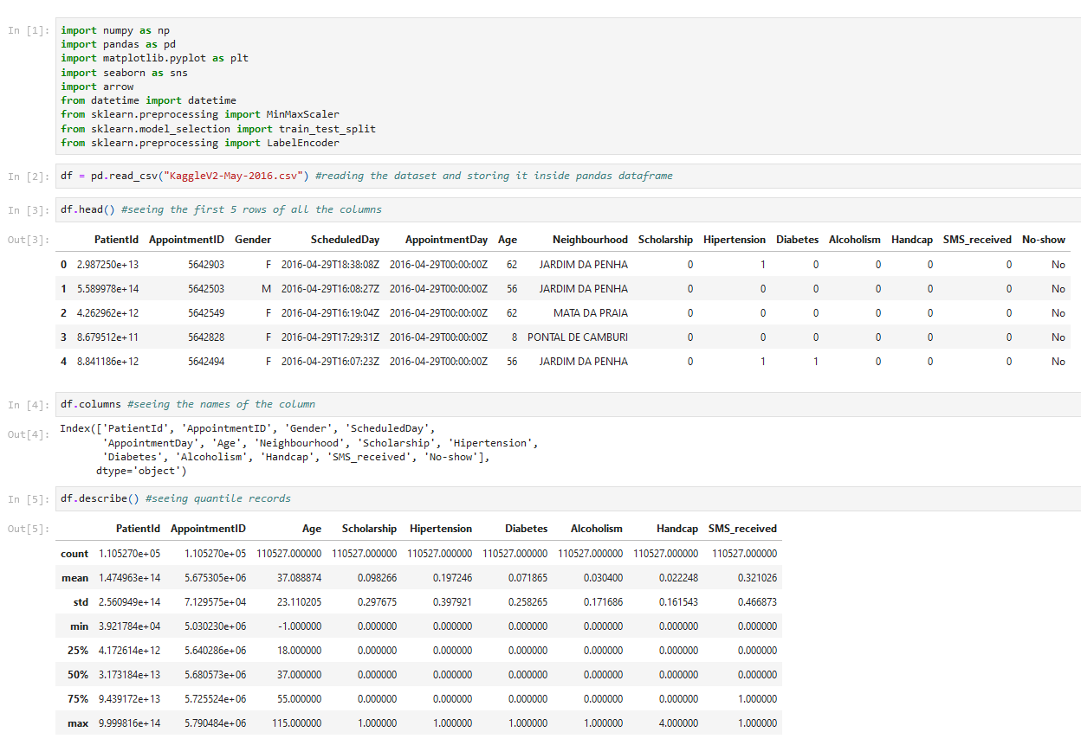
Data Profiling

Slide 7
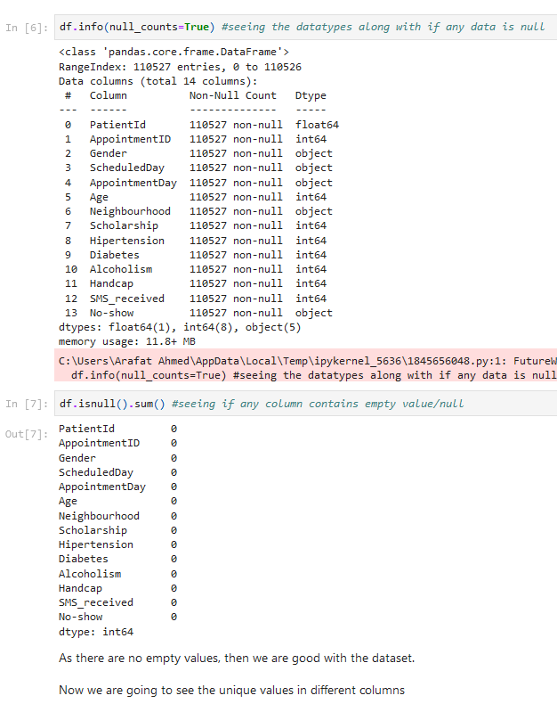
Data Profiling

Slide 8
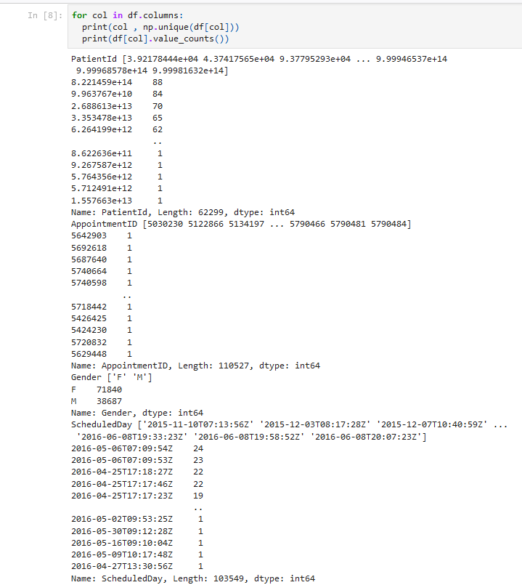
Data Profiling

Slide 9
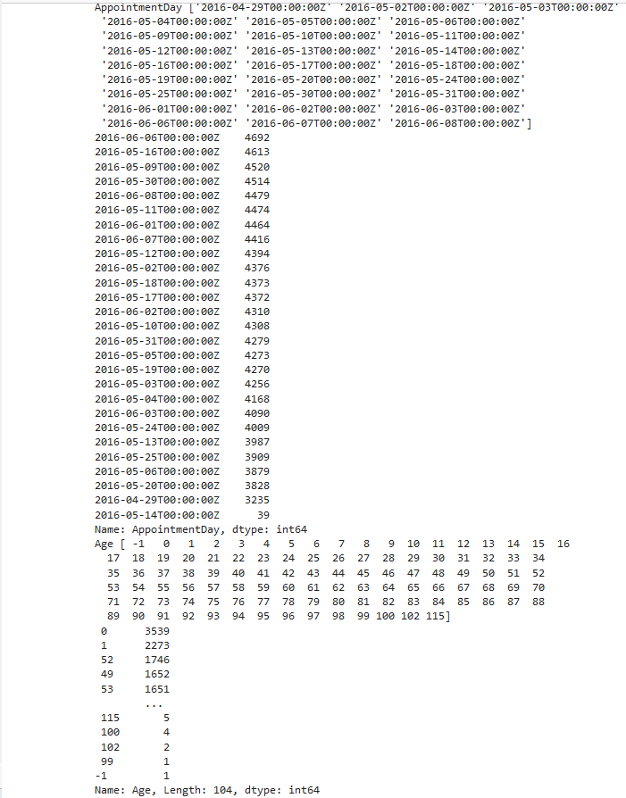
Data Profiling

Slide 10
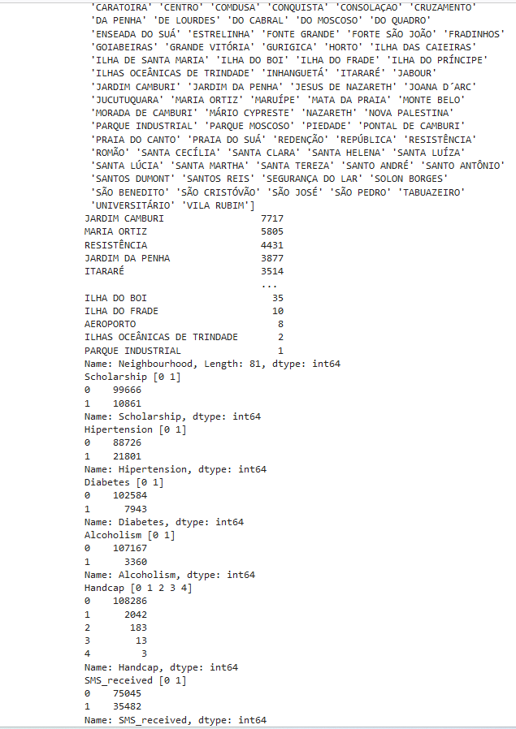
Data Profiling

Slide 11
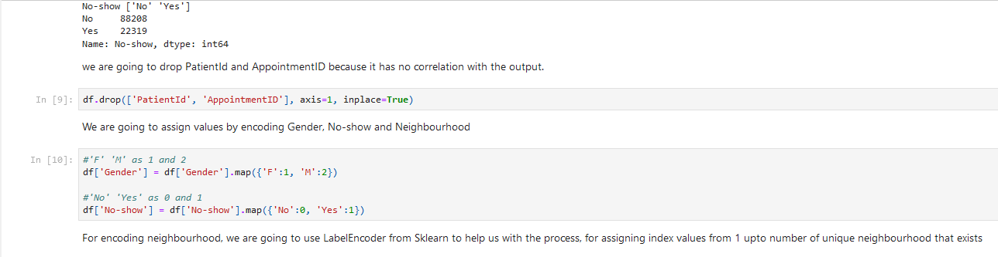
Data Preparation

Slide 12
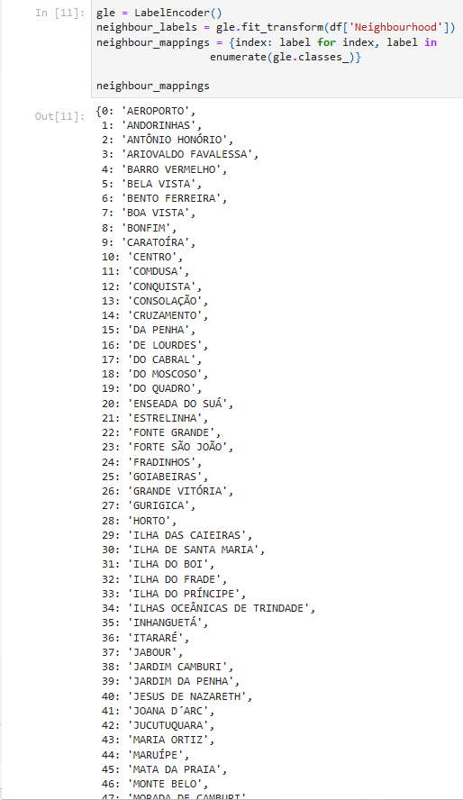
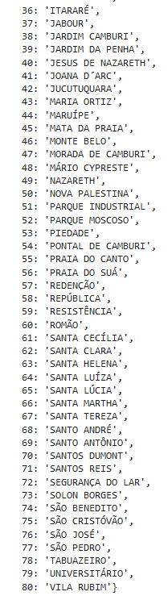
Data Preparation

Slide 13
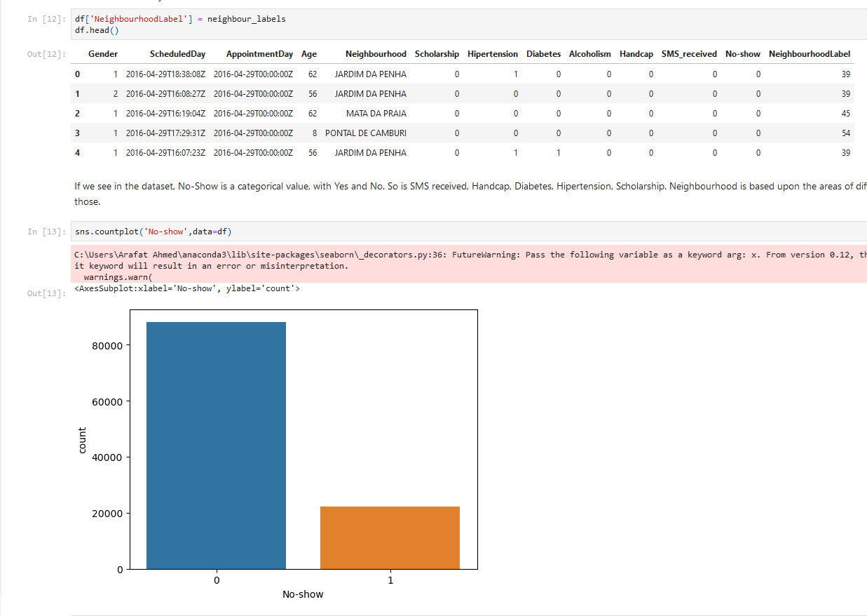
Data Visualization

Slide 14
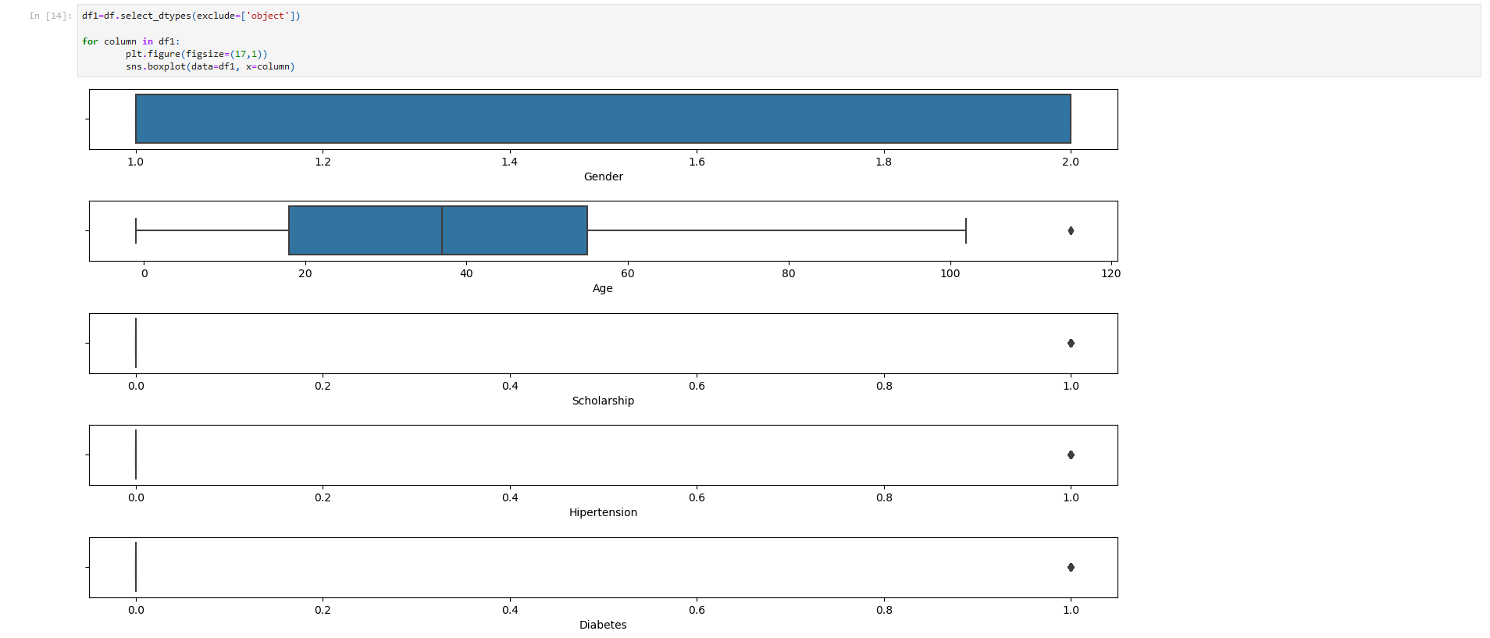
Data Preparation

Slide 15
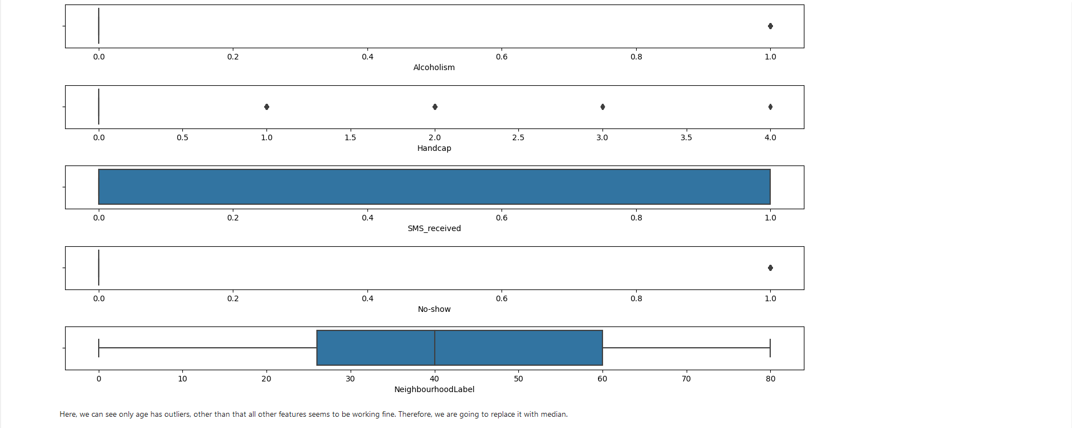
Data Preparation

Slide 16
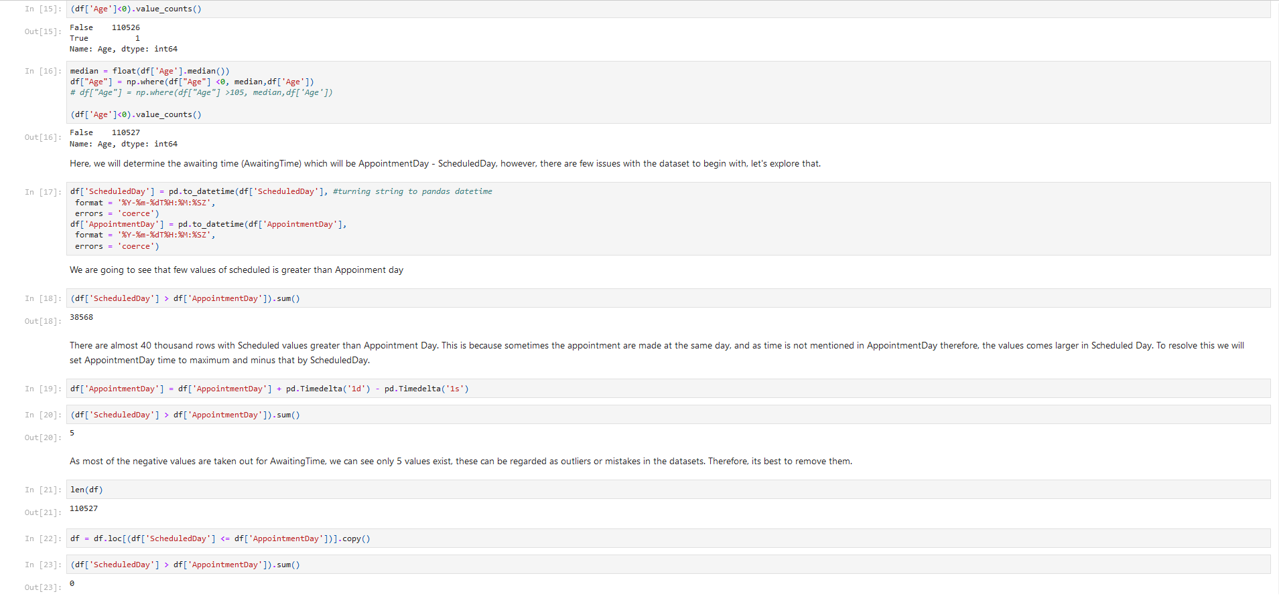
Data Mining

Slide 17
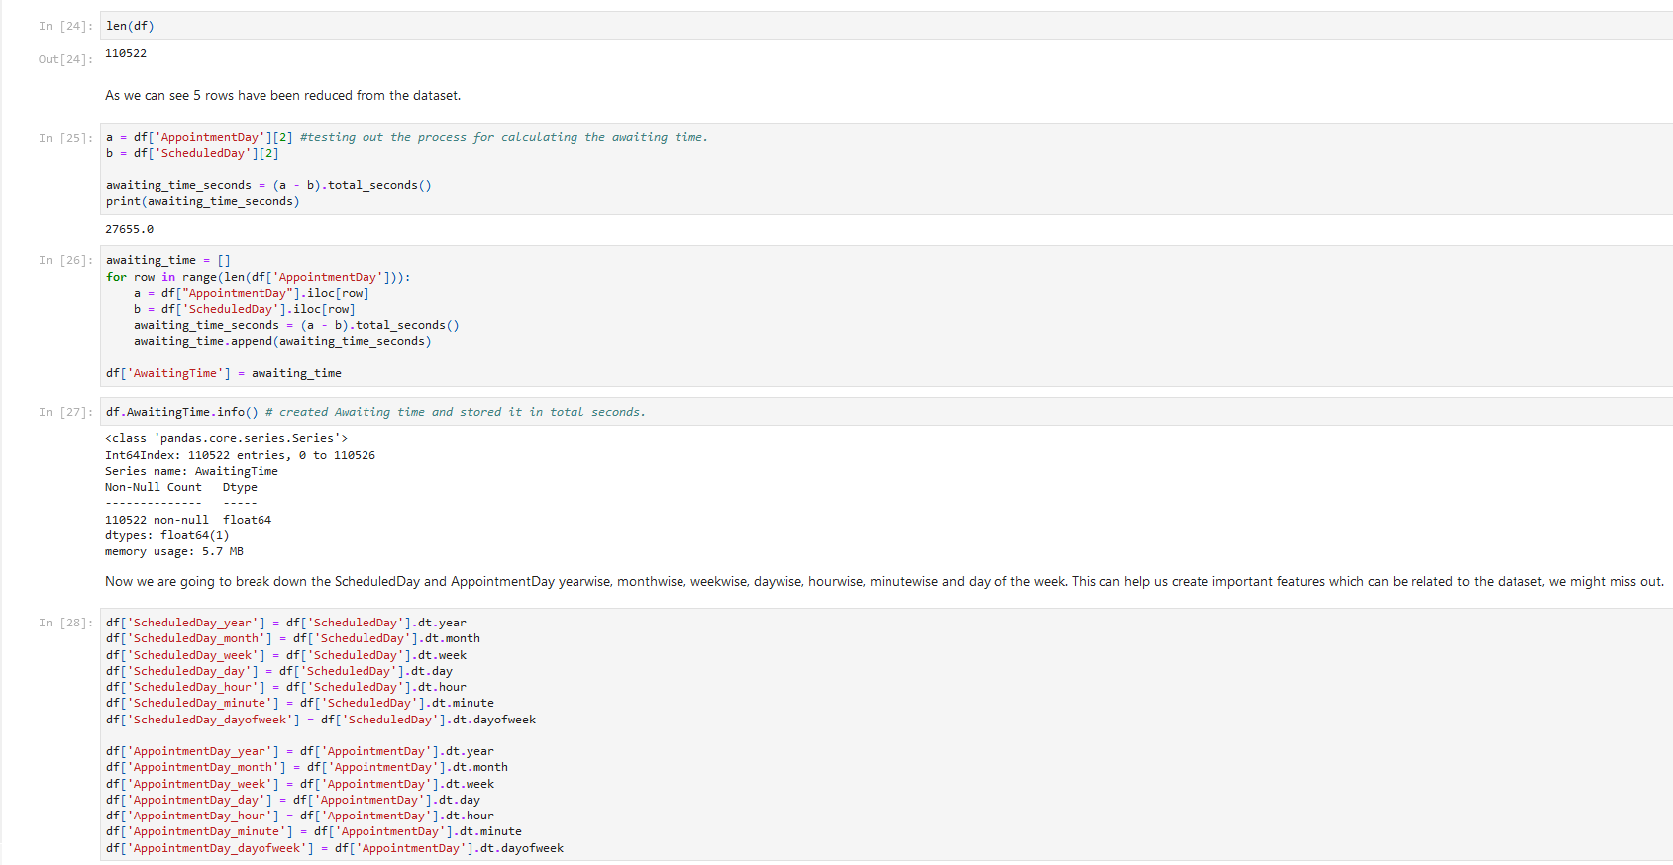
Data Preparation

Slide 18
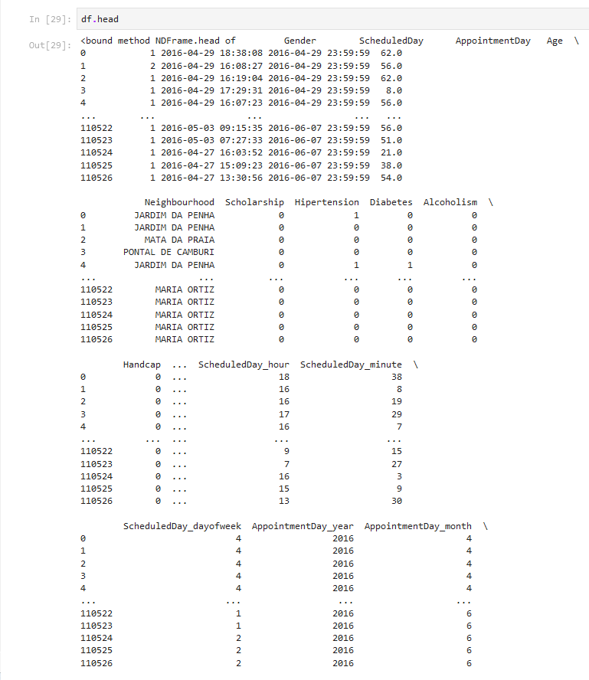
Data Preparation

Slide 19
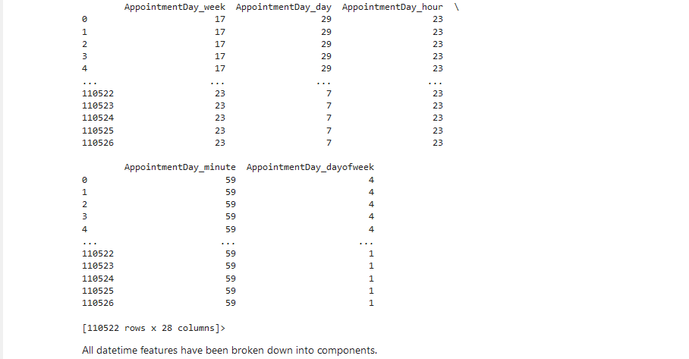
Data Preparation

Slide 20
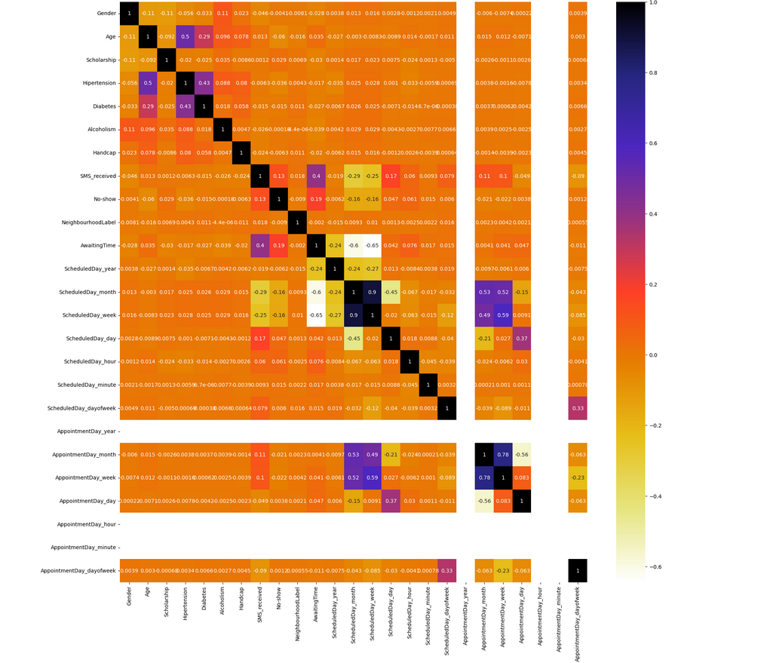
From the correlation plot we are only going to consider these features: 'SMS_received', 'AwaitingTime', 'ScheduledDay_month', 'ScheduledDay_week', as they seemed correlated with No-show. Others will not be taken into consideration for training and evaluating the model.
Data Visualization

Slide 21
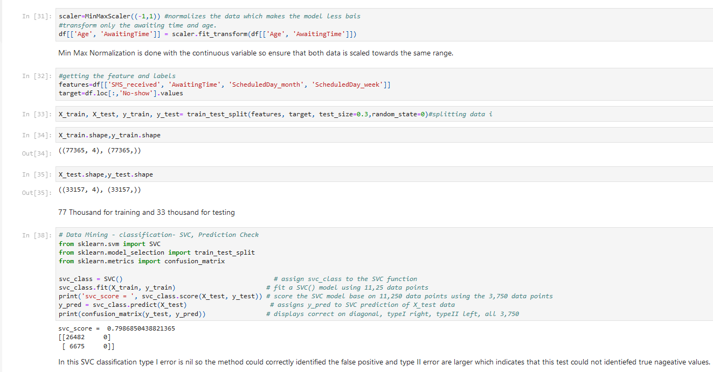
Data Mining

Slide 22
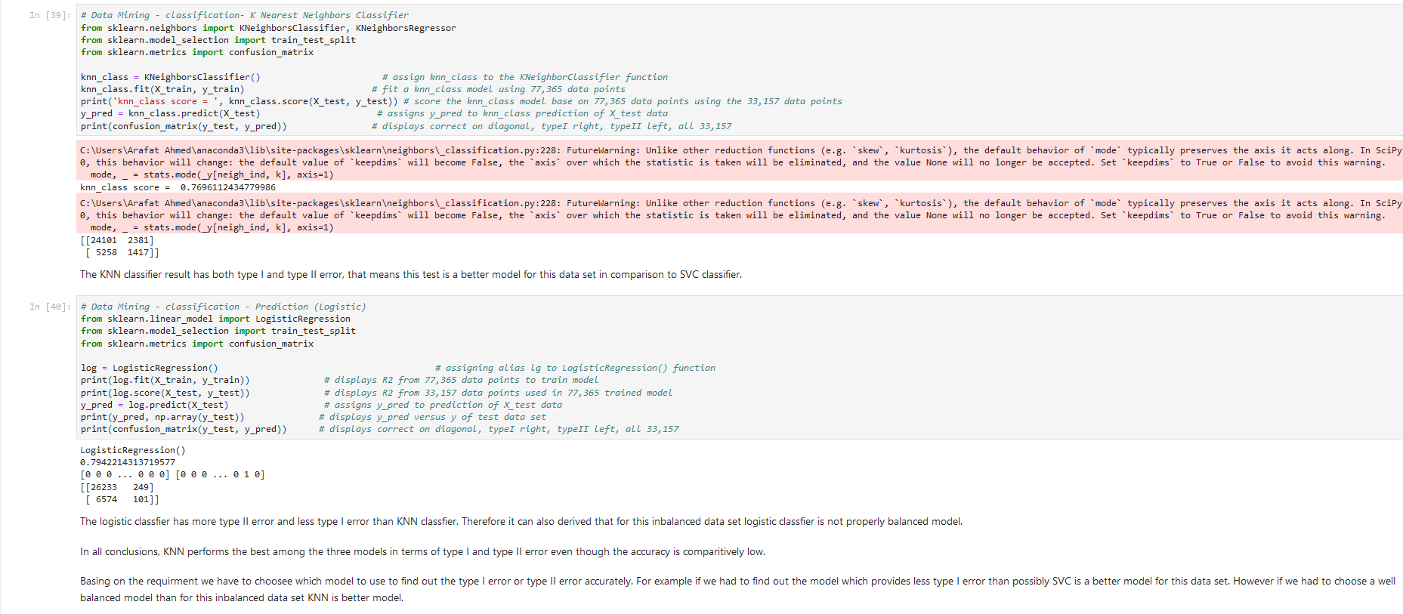
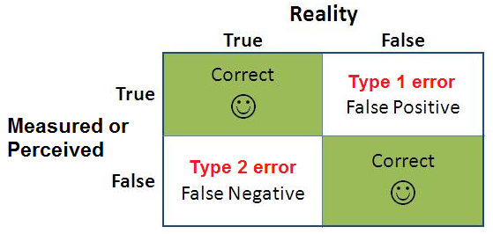
Data Mining
Overall Result

Slide 23
?

